Slide 1
A Visual Motion detection circuit suggested by drosophila connectomics
Shin-Ya Takemura, presented by Matthew Saltzman

Slide 2
Opportunity
Greater understanding of insect (fly) visual neural networks will lead to a greater understanding of complex neural networks as a whole and lead to advances towards the understanding of human neural function.
Great space to test the power of connectomics

Slide 3
Challenge
There do not exist complex synaptic maps or detailed structural pictures of these neural networks to analyze. (We have never been able to accurately depicted their structure and thusly their function)

Slide 4
Action (General)
Collect EM data
Identify and classify 27 types of nerve cells
Analyze and generate graph of fly retinal neural map (based on the 27 cells)
Perform clustering algorithms on this graph to identify clusters/systems
Analyze these clusters using multiple techniques to draw conclusions

Slide 5
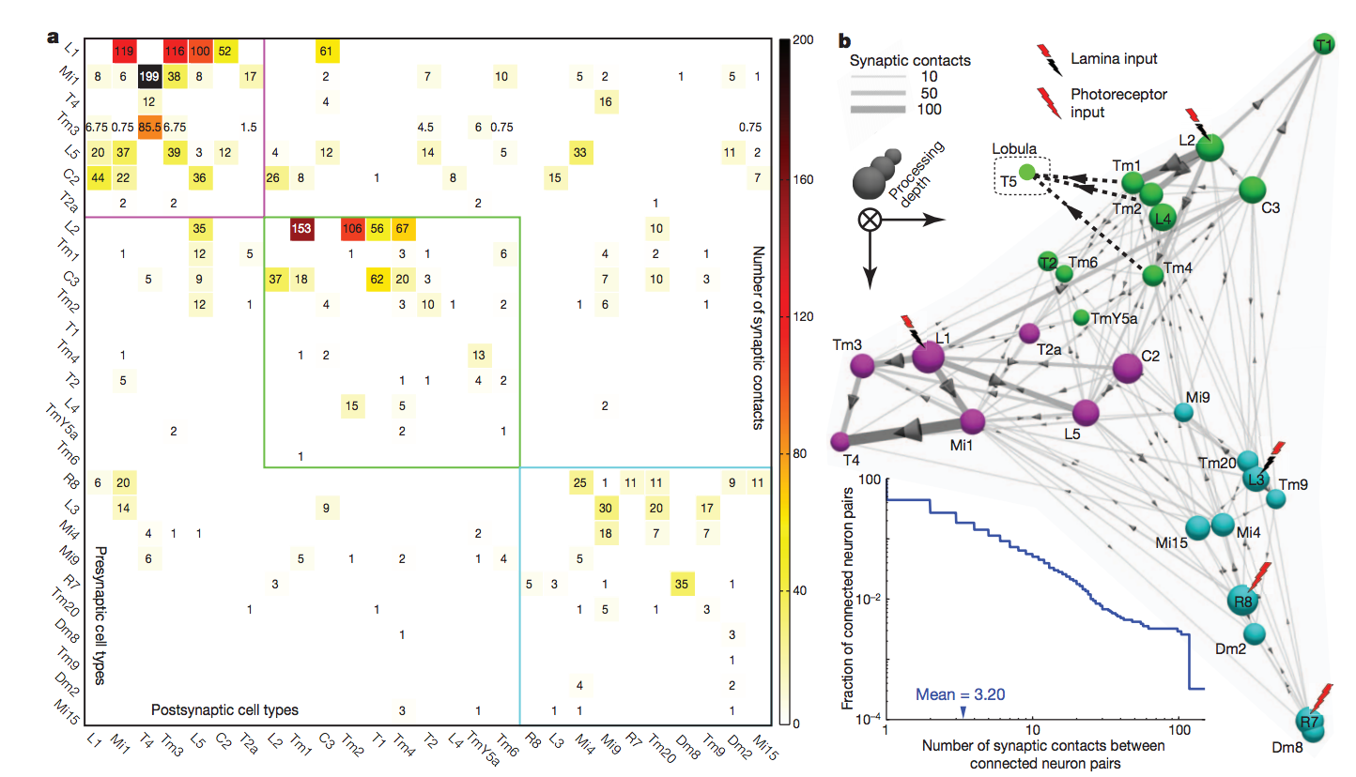
Adjacency matrix and graph

Slide 6
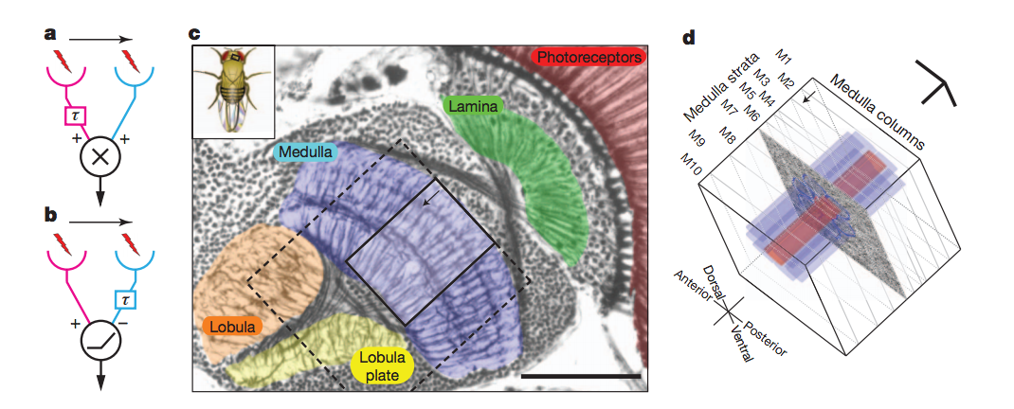
Visual system hypothesis
Hassenstein-Reichardt Visual System
Alternative Barlow-Levick-Like Visual System

Slide 7
Results
Researchers able to cluster three separate neural systems
L1, L2, L3/R7/R8
L3 found to be a part of color recognition leaving L1, L2 as motion detection circuits
Further analysis of L1 found that the cell type does not include motion/direction sensitive responses
T4 is downstream of L1 relays motion sensitive information to the lobular plate
Mi1/Tm3 found to both connect to T4 downstream of L1 but upstream of T4
Dual input system proves the earlier discussed motion detection circuits
However not enough information to prove one or the other

Slide 8
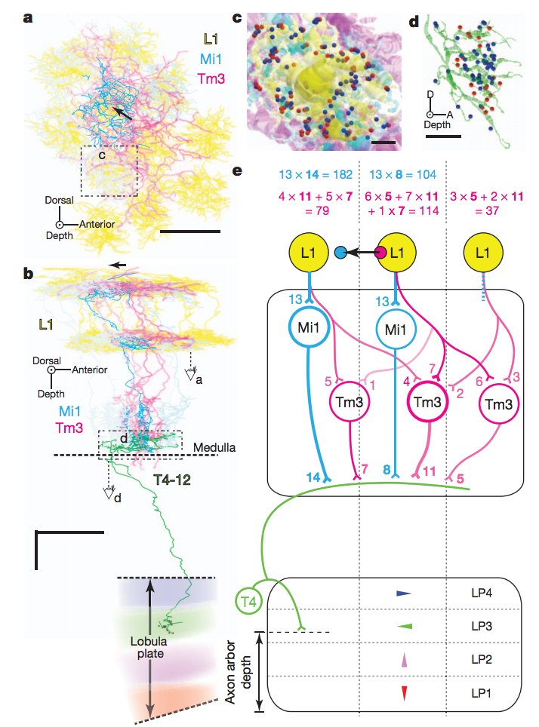
Pathway Building
The majority of L1 output goes to Mi1/Tm3 and their strongest connection lead to T4
Analyzed the strength of certain pathways (very easy with graph) to construct this neural pathway

Slide 9
Future
Significant in that the use of connectomics led to great strides in the analysis of complex neural networks
Understanding fly’s viusal networks → Understanding our own/Understanding complex networks
More importantly was the implications about the power of the field of connectomics

